Slide 1
Module 1 MCQs

Slide 2
Aptitude | GATE CS 1998 | Question 25
In a resident- OS computer, which of the following system software must reside in the main memory under all situations? (A) Assembler (B) Linker (C) Loader (D) Compiler

Slide 3
Aptitude | GATE CS 1998 | Question 25
In a resident- OS computer, which of the following system software must reside in the main memory under all situations? (A) Assembler (B) Linker (C) Loader (D) Compiler Answer: (C) Explanation: Loader is the part of an operating system that is responsible for loading programs and libraries. it places the programs into memory and also prepares them for execution.
Loading a program involves tasks such as reading the contents of the executable file containing the program instructions into memory, and then carrying out other required preparatory tasks to prepare the executable for running so any software must reside in the main memory under all situations.
The operating system starts the program by passing control to the loaded program code once the loading process is completed.
Option (C) is correct.

Slide 4
ISRO | ISRO CS 2007 | Question 25
What is the name of the technique in which the operating system of a computer executes several programs concurrently by switching back and forth between them? (A) Partitioning (B) Multi-tasking (C) Windowing (D) Paging

Slide 5
ISRO | ISRO CS 2007 | Question 25
What is the name of the technique in which the operating system of a computer executes several programs concurrently by switching back and forth between them? (A) Partitioning (B) Multi-tasking (C) Windowing (D) Paging Answer: (B) Explanation: In a multitasking system, a computer executes several programs simultaneously by switching them back and forth to increase the user interactivity. Processes share the CPU and execute in an interleaving manner. This allows the user to run more than one program at a time.

Slide 6
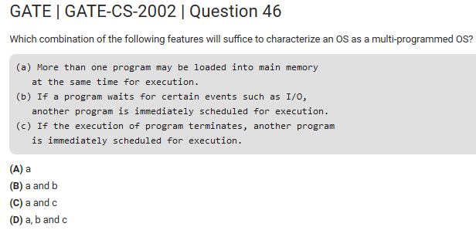

Slide 7
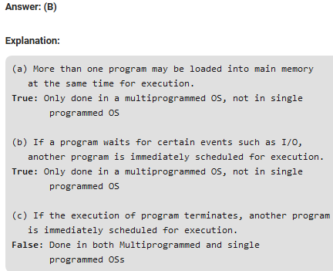

Slide 8
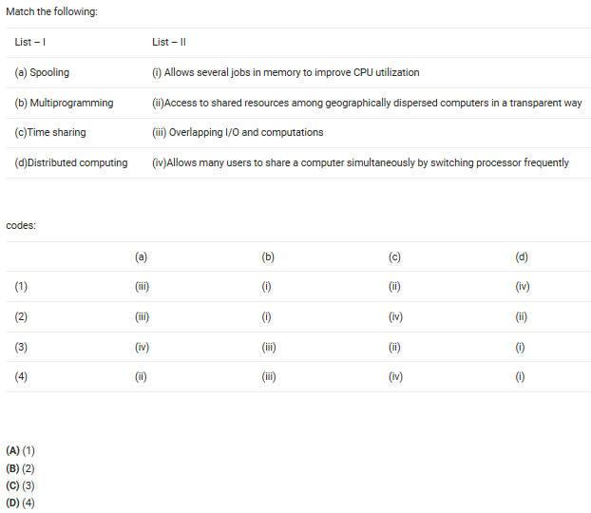

Slide 9
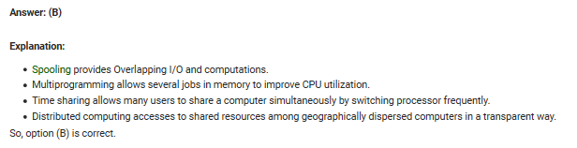

Slide 10
ISRO | ISRO CS 2017 – May | Question 71
Which of the following statement is true?
(A) Hard real time OS has less jitter than soft real time OS (B) Hard real time OS has more jitter than soft real time OS (C) Hard real time OS has equal jitter as soft real time OS (D) None of the above

Slide 11
ISRO | ISRO CS 2017 – May | Question 71
Which of the following statement is true? (A) Hard real time OS has less jitter than soft real time OS (B) Hard real time OS has more jitter than soft real time OS (C) Hard real time OS has equal jitter as soft real time OS (D) None of the above Answer: (A) Explanation: Jitter is the variation / displacement between the signals or data being sent. Hard real operating systems deal with more sensitive systems which require strict time deadlines like engine control systems, satellite launching systems etc while soft real operating systems do not require strict timing constraints and a bit delay is permissible, like mobile phones, online database systems. So hard real operating systems require minimised jitter.

Slide 12
ISRO | ISRO CS 2008 | Question 51
What is the name of the operating system that reads and reacts in terms of actual time.
A. Batch system
B. Quick response system
C. Real time system
D. Time sharing system

Slide 13
ISRO | ISRO CS 2008 | Question 51
What is the name of the operating system that reads and reacts in terms of actual time.
A. Batch system
B. Quick response system
C. Real time system
D. Time sharing system
Answer: (C) Explanation: A real-time operating system is an operating system that guarantees to process events or data by a specific moment in time.
Option (C) is correct.

Slide 14
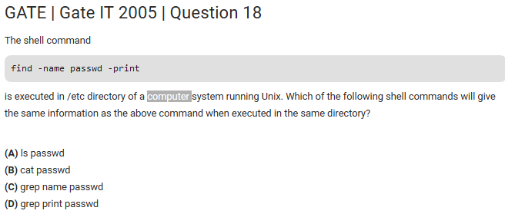

Slide 15
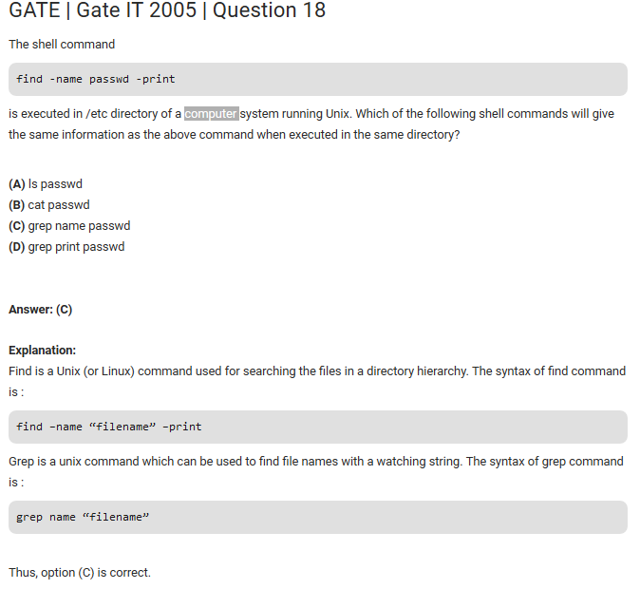

Slide 16
find command in Unix/Linux
The find command in UNIX is a command line utility for walking a file hierarchy.
It can be used to find files and directories and perform subsequent operations on them.
It supports searching by
file,
folder,
name,
creation date,
modification date,
owner and permissions.

Slide 17
Syntax :
$ find [where to start searching from] [-options] [what to find]

Slide 18
EXAMPLE-1:
To find all the files whose name is xyz.txt in a current working directory.:
# find . -name names.txt Output: # ls names.txt test.txt xyz.txt # find . -name names.txt ./names.txt

Slide 19
EXAMPLE-2:
To find all the files under /tmp directory with name xyz.txt.
# find /tmp -name names.txt
Output: # ls /tmp/ names.txt test.txt xyz.txt # find /tmp/ -name names.txt /tmp/names.txt

Slide 20
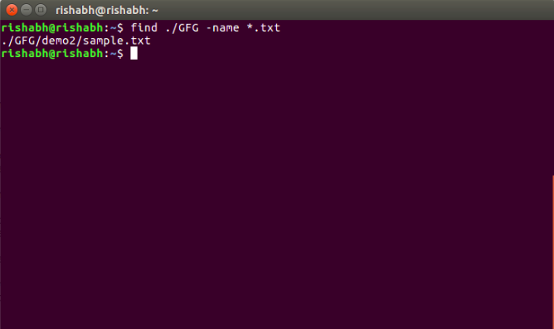
Search a file with pattern.
$ find ./GFG -name *.txt
It will give all files which have ‘.txt’ at the end.

Slide 21
grep command in Unix/Linux
The grep filter searches
a file for a particular pattern of characters, and
displays all lines that contain that pattern.
The pattern that is searched in the file is referred to as the regular expression
grep stands for globally search for regular expression and print out

Slide 22
grep command in Unix/Linux
Syntax:
grep [options] pattern [files]
Options Description
-c : This prints only a count of the lines that match a pattern
-h : Display the matched lines, but do not display the filenames.
-i : Ignores, case for matching -l : Displays list of a filenames only.

Slide 23
grep command in Unix/Linux
Consider the below file as an input.
$cat > geekfile.txt
unix is great os. unix is opensource. unix is free os.
learn operating system.
Unix linux which one you choose.
uNix is easy to learn.unix is a multiuser os.Learn unix .unix is a powerful.
1. Case insensitive search : The -i option enables to search for a string case insensitively in the give file. It matches the words like “UNIX”, “Unix”, “unix”.
$grep -i "UNix" geekfile.txt
Output:
unix is great os. unix is opensource. unix is free os.
Unix linux which one you choose.
uNix is easy to learn.unix is a multiuser os.Learn unix .unix is a powerful.

Slide 24
grep command in Unix/Linux
grep -name *FileName*
grep is used to search within a file to see if any line matches a given regular expression.
However, I have this situation - I want to write a regular expression that will match the filename itself (and not the contents of the file).

Slide 25
Consider the following statements :
UGC-NET | UGC-NET CS 2017 Nov – III | Question 73
(a) UNIX provides three types of permissions * Read * Write * Execute (b) UNIX provides three sets of permissions * permission for owner * permission for group * permission for others
Which of the above statement/s is/are true ?
(A) only (a) (B) only (b) (C) Both (a) and (b) (D) Neither (a) nor (b)

Slide 26
Consider the following statements :
UGC-NET | UGC-NET CS 2017 Nov – III | Question 73
(a) UNIX provides three types of permissions * Read * Write * Execute (b) UNIX provides three sets of permissions * permission for owner * permission for group * permission for others Which of the above statement/s is/are true ?
(A) only (a) (B) only (b) (C) Both (a) and (b) (D) Neither (a) nor (b) Answer: (C) Explanation: UNIX provides Read, Write and Execute permisision on files UNIX provides three sets of permissions
permission for owner
permission for group
permission for others

Slide 27
UGC-NET | UGC NET CS 2015 Dec – III | Question 56
In Unix, the command to enable execution permission for file “mylife” by all is ____________. (A) Chmod ugo + X myfile (B) Chmod a + X myfile (C) Chmod + X myfile (D) All of the above

Slide 28
UGC-NET | UGC NET CS 2015 Dec – III | Question 56
In Unix, the command to enable execution permission for file “mylife” by all is ____________. (A) Chmod ugo + X myfile (B) Chmod a + X myfile (C) Chmod + X myfile (D) All of the above Answer: (D) Explanation: In Unix, the command to enable execution permission for file “mylife” by all are: Chmod + X myfile Chmod a + X myfile Chmod ugo + X myfile So, option (D) is correct.

Slide 29
UGC-NET | UGC NET CS 2015 Jun – III | Question 75
The unix command: $ vi file1 file2 (A) Edits file1 and stores the contents of file1 in file2 (B) Both files i.e. file1 and file2 can be edited using ‘ex’ command to travel between the files (C) Both files can be edited using ‘mv’ command to move between the files (D) Edits file1 first, saves it and then edits file2

Slide 30
UGC-NET | UGC NET CS 2015 Jun – III | Question 75
The unix command: $ vi file1 file2 (A) Edits file1 and stores the contents of file1 in file2 (B) Both files i.e. file1 and file2 can be edited using ‘ex’ command to travel between the files (C) Both files can be edited using ‘mv’ command to move between the files (D) Edits file1 first, saves it and then edits file2 Answer: (B) Explanation: By command $ vi file1 file2: Both files i.e. file1 and file2 can be edited using ‘ex’ command to travel between the files. So, option (B) is correct.

Slide 31
When you first invoke vi, you can name more than one file to edit, and then use ex commands to travel between the files.
For example: $ vi file1 file2
edits file1 first.
After you have finished editing the first file,
the ex command :w writes (saves) file1 and
:n calls in the next file (file2).

Slide 32
GATE | Gate IT 2005 | Question 19
A user level process in Unix traps the signal sent on a Ctrl-C input, and has a signal handling routine that saves appropriate files before terminating the process. When a Ctrl-C input is given to this process, what is the mode in which the signal handling routine executes?
(A) kernel mode (B) superuser mode (C) privileged mode (D) user mode Answer: (A)

Slide 33
GATE | Gate IT 2005 | Question 19
A user level process in Unix traps the signal sent on a Ctrl-C input, and has a signal handling routine that saves appropriate files before terminating the process. When a Ctrl-C input is given to this process, what is the mode in which the signal handling routine executes?
(A) kernel mode (B) superuser mode (C) privileged mode (D) user mode

Slide 34
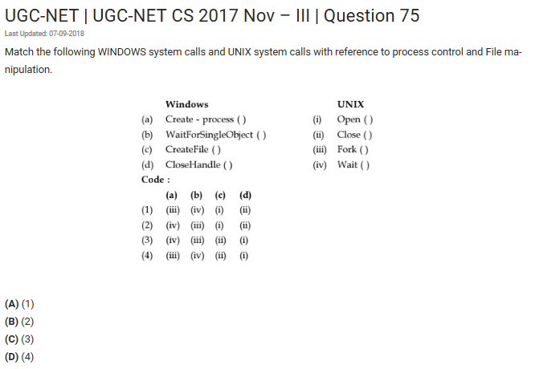

Slide 35
Answer: (A) Explanation:
In UNIX Wait() is used to WaitForSingleObject() .
In UNIX Fork() is used for create-process().
In UNIX Create() is used for CreateFile().
In UNIX Close() is used for CloseHandle()
So, option (A) is correct.

Slide 36
UGC-NET | UGC NET CS 2016 July – III | Question 67
What is the function of following UNIX command ?
WC – l <a >b&
(A) It runs the word count program to count the number of lines in its input, a, writing the result to b, as a foreground process. (B) It runs the word count program to count the number of lines in its input, a, writing the result to b, but does it in the background. (C) It counts the errors during the execution of a process, a, and puts the result in process b. (D) It copies the ‘l’ numbers of lines of program from file, a, and stores in file b.

Slide 37
UGC-NET | UGC NET CS 2016 July – III | Question 67
Last Updated: 24-04-2018 What is the function of following UNIX command ?
WC – l <a >b&
(A) It runs the word count program to count the number of lines in its input, a, writing the result to b, as a foreground process. (B) It runs the word count program to count the number of lines in its input, a, writing the result to b, but does it in the background. (C) It counts the errors during the execution of a process, a, and puts the result in process b. (D) It copies the ‘l’ numbers of lines of program from file, a, and stores in file b. Answer: (B) Explanation:
WC – l <a >b& It runs the word count program to count the number of lines in its input, a, writing the result to b, but does it in the background. So, option (B) is correct.

Slide 38
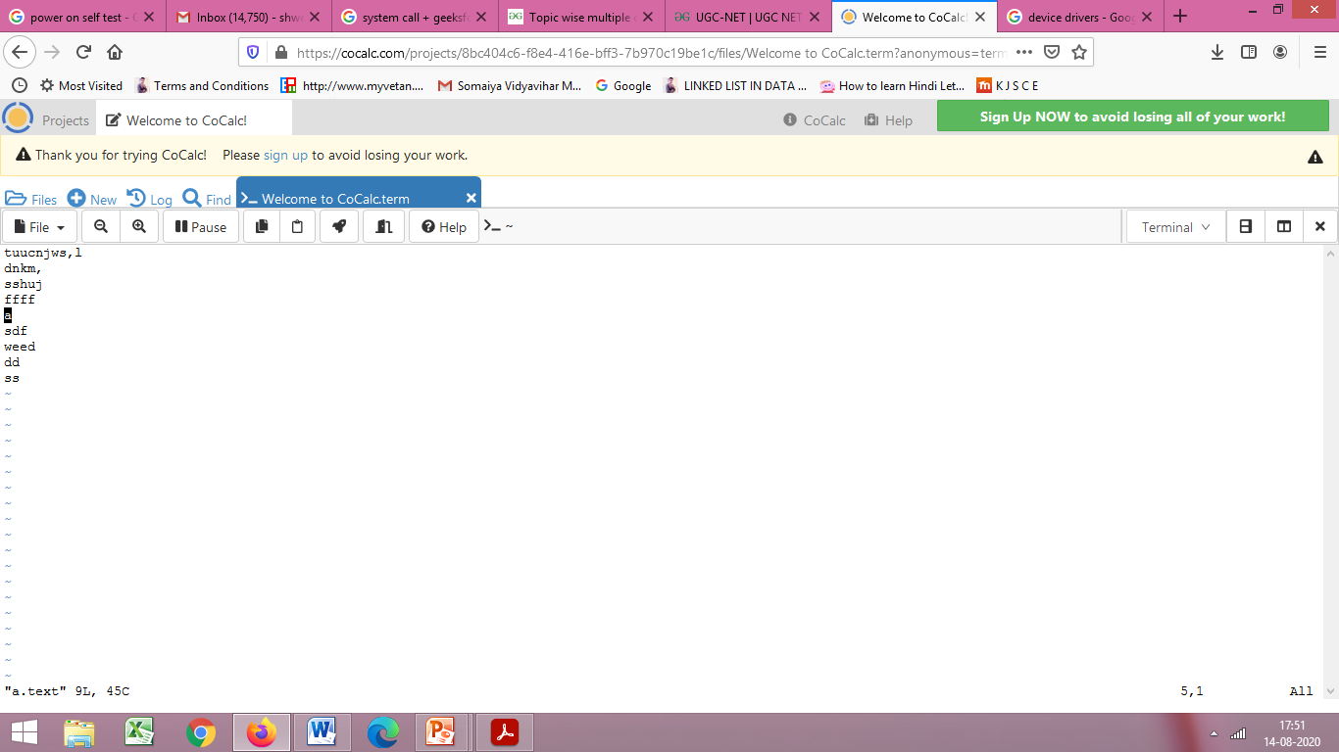
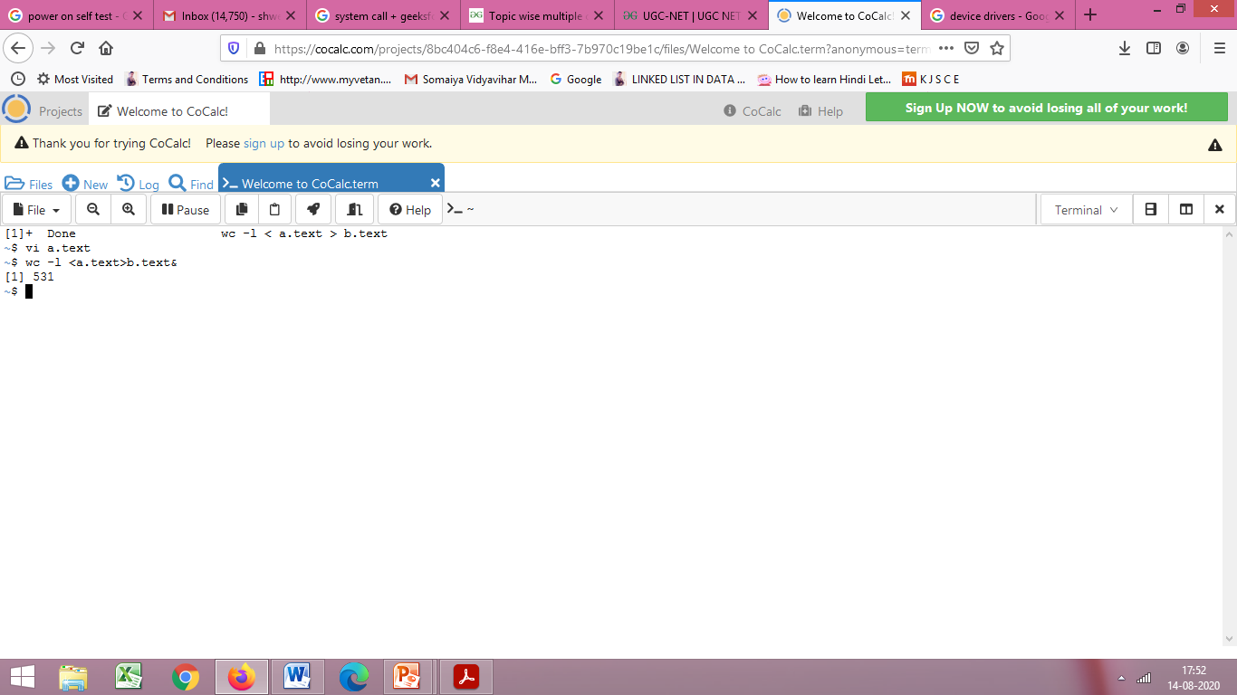

Slide 39

